Slide 1
AGILE Presentation
Student: Stephanie Voutselakos
CS-250-J7315 Software Development Lifecycle 23EW6
August 11, 2024

Slide 2
Table of Contents
Introduction
Scrum-Agile Team Roles
Agile Phases of the Software Development Life Cycle
Waterfall vs Agile
Choosing the Right Approach

Slide 3
INTRODUCTION
At ChadaTech, we specialize in custom software design and development for both domestic and international clients.¹ To remain relevant in this everchanging landscape we must be able to pivot quickly, adapt our processes and embrace an agile culture. This presentation will highlight the steps our Team took to get us there and how we can adapt these processes to successfully embrace this culture company wide.

Slide 4
SCRUM AGILE TEAM ROLES

Slide 5




MEET OUR TEAM
Product Owner
Scrum Master
Development Team
Testers²

Slide 6
PRODUCT OWNER Key Attributes
Crucial for communication but also to gain the trust of the Team, the Product Owner must be approachable in order to foster the right culture with the Team.
KNOWLEDGE
Intimate knowledge of the customer's needs Understanding of the big picture
AUTHORITY
Has the authority to make monetary and crucial decisions Has good judgement and understanding of how decisions impact the entire project
PRIORITY
Can decipher through various levels of the project to understand the urgency and importance of how different facets of the project fit together
Understands the importance of open communication between departments. Keeps the communication flowing directly and between departments
APPROACHABLE
RESPONSIVE

Slide 7
Scrum Master KEY ATTRIBUTES
In tandem with influence, is engaging with the Team and is humble enough to be approachable and take responsibility and ownership gaining the trust of the Team.
KNOWLEDGE
Strong tie to product manager with understanding of the big picture. Ability to drive the pace of the project, understanding all of the facets
COLLABORATE
Fosters collaboration amongst the Team to keep the project moving along with open communication and encouragement of sharing ideas.
INFLUENCE
Ability to draw ideas from the Team without simply telling what needs to be done. Fosters a culture that inspires the Team to buy in to the program and believe in a greater purpose.
Drives a relentless pursuit of continuous improvement. Does not settle and establishes the tone with the Team to buy in to the same.
ENGAGING
RELENTLESS IMPROVEMENT

Slide 8
DEVELOPMENT TEAM LEAD KEY ATTRIBUTES
PLANNER
Ability to take the vision from the project manager , research and develop the core ideas in to a tangible plan.
DETAIL ORIENTED
Understands the ramifications of change and the impact on other areas and can articulate and communicate effectively
CODING KNOWLEDGE
Understands how to optimize the right language for various applications and how, down the line why one might be better than another.
Works well with other departments to understand changing demands and shifting priorities to steer Team effectively and efficiently.
CONSTRUCTIVE

Slide 9
TESTING TEAM KEY ATTRIBUTES
Constant drive for improvement and progress. An inherant desire to self- improve and grow.
CURIOSITY
Requires a continuous drive to explore, poke, ask questions, push the envelope and think beyond what is in front of you
EXPRESSIVE
The ability to express oneself in a dynamic and articulate manner with care and respect to foster collaboration and progress
RELIABLE
Can be counted on to deliver on time and consistently. The testing phase can often be crunched as plans change and develop perhaps not as planned and yet the deadline remains the same.
Similar to curiosity, must possess the mindset that seeks out solutions and better ways to address a point or an opportunity that presents itself.
LEARNER
PROBLEM SOLVING

Slide 10
AGILE PHASES of the Development lifecycle

Slide 11
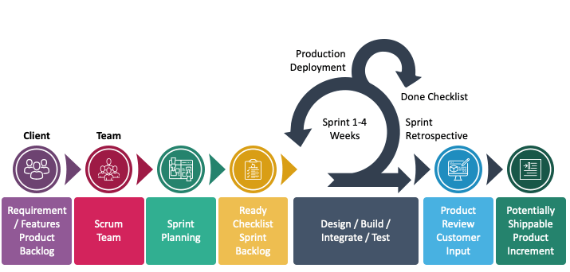
Software Development Life Cycle - SDLC
https://www.sketchbubble.com/en/presentation-agile-software-development-life-cycle.html

Slide 12
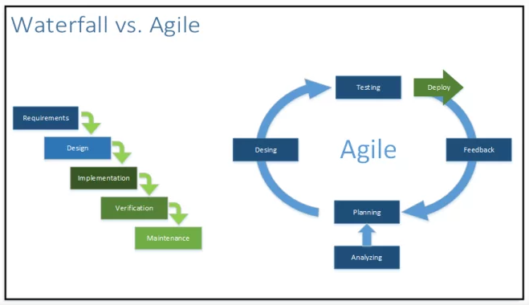
Waterfall VS Agile
Waterfall method relies on a series of steps followed in an exact order
Waterfall method has little room to pivot if the plan changes up
Agile method is designed to include continuous progress with constant mini hurdles
https://www.devteam.space/blog/agile-vs-waterfall-which-methodology-is-right-for-your-project/
Agile method can be more expensive and be harder to give dates when products will be delivered

Slide 13
Choosing the Right Approach
Reasons to opt in with Waterfall
Prime for the Agile approach
Projects that are subject to strict regulations
Solid or fixed in place deadlines leading in.
Well known and established facets from the start.
Government projects are typically a good example of where waterfall would make sense.
Customer is not sure of all aspects at the start
The scope and or requirements of the project are subject to change
The client wants to be more involved in the process.

Slide 14
THANK YOU
Student: Stephanie Voutselakos
Ellen.voutselakos@snhu.edu
CS-250-J7315 Software Development Lifecycle 23EW6

Slide 15
SOURCED MATERIALS
¹Page 3 Introduction – ChadaTech company overview – Week 7 instructions
²Page 5 Scrum Team photos - CS 250 Course Overview YouTube Video
³Page 11 SDLC graphic Sketch Bubble - https://www.sketchbubble.com/en/presentation-agile-software-development-life-cycle.html
⁴Page 12 Waterfall vs Agile The DevTeam- https://www.devteam.space/blog/agile-vs-waterfall-which-methodology-is-right-for-your-project/

